Slide 1



UNIVERSITY INSTITUTE OF ENGINEERING
COMPUTER SCIENCE ENGINEERING
Bachelor of Engineering
Robotics Process Automation(20CST-472)
Prepared By: Ms. Jyoti Chandel(E15580
Topic: RPA Architecture
DISCOVER . LEARN . EMPOWER

Slide 2
RPA Architecture
RPA is a technology, which allows anyone today to configure computer software or a robot for emulating and integrating human actions and interacting with digital systems for executing a business process.
RPA robots, utilizing the user interface, capture data like humans do and manipulate applications. They interpret, communicate and trigger responses with other systems in order to perform a wide variety of repetitive tasks. RPA robot never sleeps, makes zero mistakes, and also costs less than an employee.
One of the most challenging decisions that Organizations need to go through is deciding the ideal toolset that they may apply to their implementation of RPA.

Slide 3
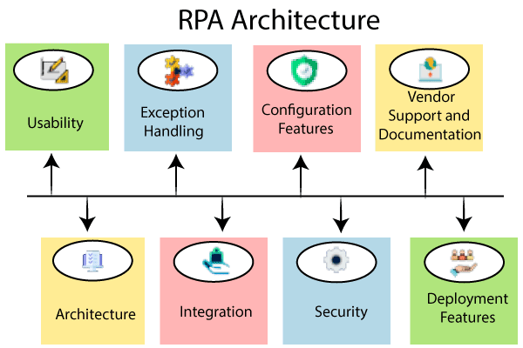

Slide 4
RPA Architecture
RPA architecture is the most critical factor that needs to be analyzed. But for the time being, the essential element that needs to be understood well is the architecture of the particular product. This also helps in understanding the implications of where it should not be used.
Usability: Usability is the most important factor that plays a significant role in the decision-making as well, and for an automation tool, usability should be even more perfect as there is a limited number of steps for configuration concerns. It makes the overall configuration process and the administration process more efficient if it is easier to understand by others. The more accessible software can ensure quicker scalability, ease of deployment, and higher levels of adoption by the customers.
Integration: An ideal RPA tool should be able to integrate with various other systems and technologies that might be deployed in an organization’s business processing. The stronger integration capabilities, the better and robust automation is achieved by them.

Slide 5
RPA Architecture
4. Security
RPA solutions will have their hands on the sensitive data of an organization when an RPA solution is deployed there. And as part of this, there should not be an underestimate of the security features and measures that are quintessential of an automation toolkit.
5. Configuration Features
Every RPA application holds a feature designed in specific to accelerate and also to simplify the editing of the configuration all the time. This ensures that the effective deployment of automation and also adds a lot of support towards building the required internal capabilities.

Slide 6
RPA Architecture
6. Deployment features
When the configuration and testing guidelines are all crossed, then the user needs a deployment feature. Some businesses or organizations require specific deployment scenarios where powerful deployment toolset is appreciated.
7. Vendor Support and Documentation
Not any particular tool is perfectly fit for every process in the organization. The vendor support and documentation is a vital part of the RPA architecture.

Slide 7
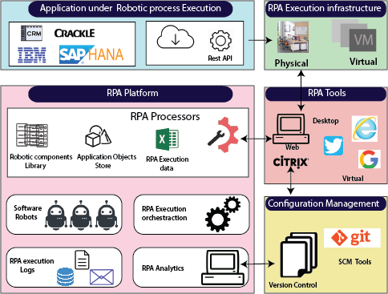
RPA Architecture

Slide 8
RPA workflow
The vendors provide strong support to any particular RPA tool for better resources.
There are five areas of RPA architecture, which are given below:
1. The application under Robotic Process Execution
2. RPA Platform
3. RPA execution infrastructure
4. RPA (Robotic Process Automation) tool
5. Configuration Management
Robotic Process management focuses on RPA architecture. RPA architecture is a critical factor that needs to be analyzed.

Slide 9
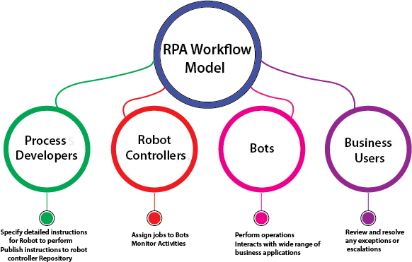
RPA workflow
The workflow model explains the use of RPA in business to perform the tasks. The RPA developer provides detailed instructions to the Robots to perform the task and publish the information in the Robot controller.

Slide 10
RPA workflow
The Robot controller assigns jobs to the Bot and also monitor the activities of Bot (automated programs). The Bot performs the task which is given by the Robot controller. Bot interacts with a wide range of business applications. There are four steps in the RPA workflow model, which are given below:
1. Process Developers:The Process Developers or RPA developers provide instructions for the Robot to perform the task. They also publish the instruction to the Robot controller Repository.
2. Robot Controllers: The Robot controller allotted the jobs to Bot (automated programs) and monitored the activities. It acts as a master repository to the defined roles and facilitates version control.

Slide 11
RPA workflow
3. Bots
The bots are configurable software fixed up to perform and control the task which is assigned by the developer. The RPA Bots can work with both attended and unattended modes.
4. Business Users
The business users can review and resolve any errors or exceptions. RPA is the technology to automate the business processes. The products in RPA commonly create the scripts which can directly access the applications.

Slide 12
THANK YOU

